Slide 1
WELCOME!
Presentation of MS Word In PowerPoint
Aligarh Institute of Technology
First Year Software Section B
Presented by Group: 05

Slide 2
Topic
PAGE LAYOUT IN MS WORD & IT’S USES
GROUP LEADER | GENERAL REGISTER NUMBER
Qazi Jawad Uddin (Group Leader) | GR NO: 82
Faizan Haris | GR NO: 83
Amman Mukhtar | GR NO: 110
Muhammad Saad | GR NO: 85

Slide 3
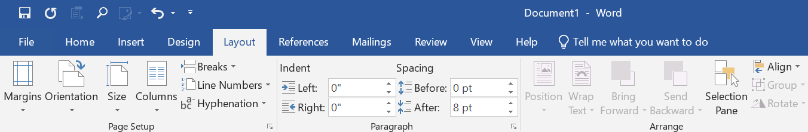
1
2
3
PAGE LAYOUT TAB:
The Page Layout Tab holds all the options that allow you to arrange your document pages just the way you want them. You can set margins, apply themes, control of page orientation and size, add sections and line breaks, display line numbers, and set paragraph indentation and lines.
TYPES OF LAYOUT TAB:
There are three types in page layout tab.
1. Page Setup Group
2. Paragraph Group
3. Arrange Group

Slide 4
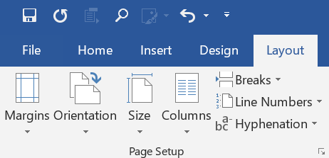
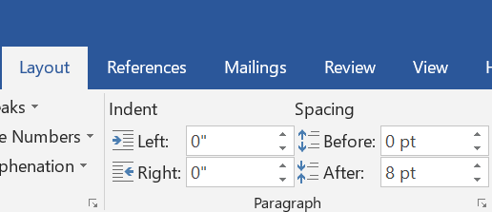
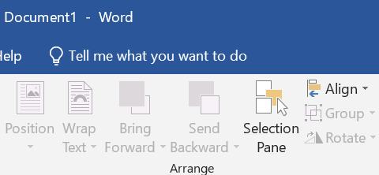
1
2
3
ARRANGE GROUP:
It contains following options:
Position
Wrap Text
Bring Forward
Send Backward
Selection Pane
Align
Group
Rotate
PAGE SETUP GROUP:
It contains following options:
Margins
Orientation
Size
Columns
Breaks
Line Numbers
Hyphenation
PARAGRAPH GROUP:
It contains following options:
Indent
Spacing
Left
Right
Before
After

Slide 5
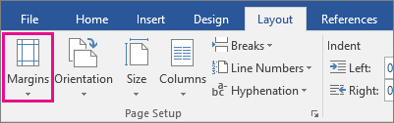
What is a page layout document?
USE OF PAGE LAYOUT
Margins are the blank spaces that line the top, bottom, and left and right sides of a document. They are important because they help make a document look neat and professional.
Orientation is used for the positioning or overall layout of an item related to other items. For example, Portrait and Landscape are two common orientations
Word default paper size is 8.5 x 11 inches. If you use a different size more frequently than the default, you can change the default size of all new documents. You can easily to change the paper size.

Slide 6
Columns can use to improve readability, especially with certain types of documents—like newspaper articles, etc.
Breaks is used to divide a page and format documents of all sizes.
Line Numbers useful when you need to refer to specific lines in a document
Hyphenating will break long words across lines in order to smooth out the side margins of a document.

Slide 7
Indent the paragraph, type the distance you want in the Left or Right box under Page Layout.
Spacing:
Choose the number of line spaces you want or select Line Spacing Options, and then select the options you want under Spacing.

Slide 8
Position tab, the default position of a text box is relative to the column and paragraph to which it is anchored.
Wrap Text is used to add an image in your document and make the text flow around it in a way that follows the shape of the image.
Bring forward is used to bring an object one step closer to the front,
Send Backward is used to send an object one step closer to the Back,

Slide 9
Selection pane is used to manage objects in your document: re-order them, show or hide them, and group or ungroup them.
Align is used to align the paragraph left-aligned, right-aligned, centered, or justified text.
Group shapes, pictures, or other objects. Press and hold CTRL and select shapes, pictures, or other objects to group.
Rotate is used to turn an object upside-down.

Slide 10
Thank You!

